Slide 1
KV6002 Week 2 – Planning & Interviewing Clients
Dr Rebecca Nicholson

Slide 2

KV6002 Team Project and Professionalism – Week 1
Today I will:
1. Cover Planning Expectations
2. Give tips on interviewing clients

Slide 3
Planning Expectations
Reminder - Assignment 1 is due on 9th Feb
For this you are required to produce a powerpoint (in the format specified) to support a presentation you give to your supervisor in Week 4.
We expect that you cover:
Info about your group
Info about your client
Info about your intended users
Timelines

Slide 4

Group Info
1. Who is in your group?
Self explanatory!
2. Who will do what?
Remember – you are working as full stack developers.
3. How you will integrate the work
Be specific about each persons contribution.
BUT
Think about how you will bring these together into a functional system at the end.

Slide 5
Full Stack Development
Each subsystem should have a ‘slice of functionality’.
Should be splitting by function rather than by element.
Everyone should input into all elements such as the database, the user interface.
Also means all team members should be at the client meeting.

Slide 6
Integration is Key!
You need to plan how to integrate those subsystems.
You all created something – how do you bring it together and ensure it’s functional?
Deadlines become important – when will you bring it together?
How will you know you’re on track?

Slide 7
Tasks / Deadlines
We want to see that you’ve considered what is viable in the timeframe.
We want to see some kind of plan – either Gantt chart or similar.

Slide 8
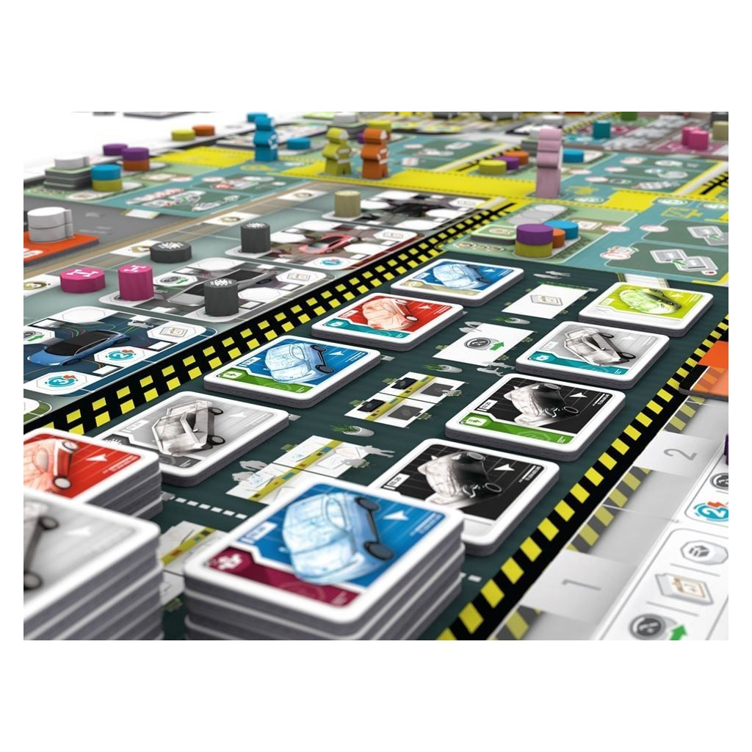
Visualising Plans
Several Options:
Gantt Chart
Scrum board
Kanban board

Slide 9
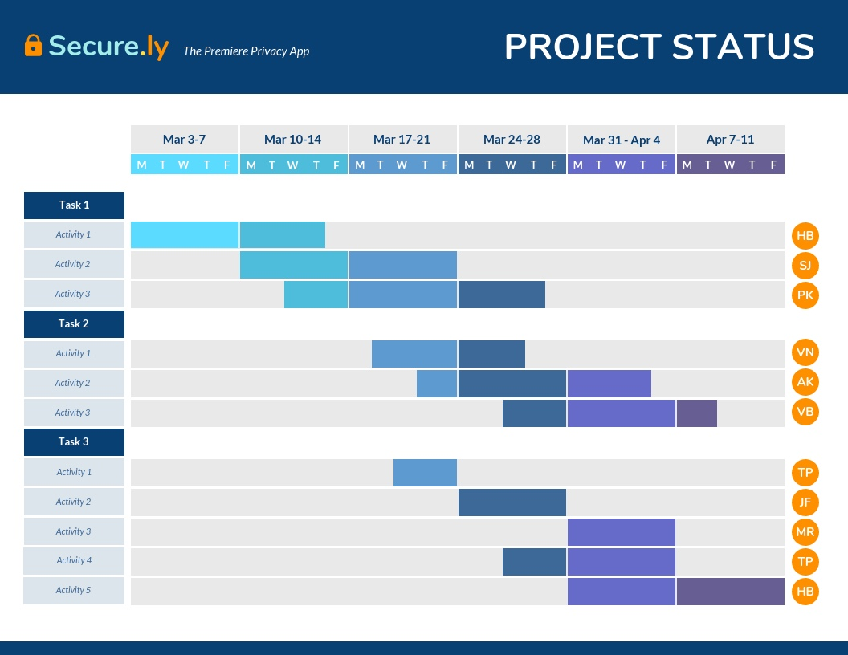
Gantt Chart
Rows visualise length of time tasks take.
Colours denote timeframes / tasks.

Slide 10
Gantt Chart – Positives / Negatives
Good overview.
Easy to see how long tasks take
Easy to see how they fit into overall
Time consuming to create.
Not easily alterable.
Difficult to see what assigned to who.

Slide 11
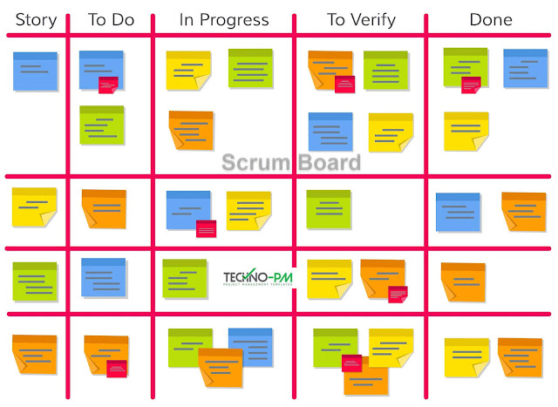
Scrum Board
Story – anything identified in your planning phase.
To Do – anything that makes the list of necessary requirements.
In Progress – what people are currently working on
To Verify – things done that need testing / other sign off
Done – completed tasks

Slide 12
Scrum Board – Positives / Negatives
Good visual overview.
Very task based.
Easy to alter / amend.
Sometimes hard to see timescales.
Sometimes gets crowded.
Not always easy for ‘outsider’ to understand.

Slide 13
Kanban Board
Requirements on the left.
Ready = agreed tasks
In progress = currently working on
Done = completed.

Slide 14
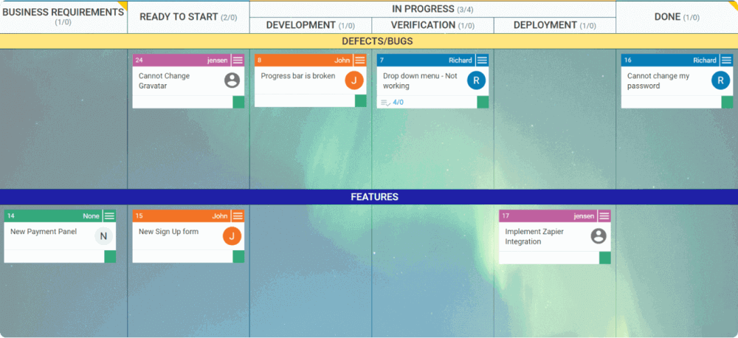
Kanban Board – Positives / Negatives
Good visual overview.
Very task based.
Easy to alter / amend.
Sometimes hard to see timescales.
Sometimes gets crowded.
Not always easy for ‘outsider’ to understand.

Slide 15
Kanban vs Scrum?
Scrum boards used for sprints
Kanban for a larger overview and has no fixed end.
Kanban stays throughout project.
Scrumboard cleared between sprints.
Team roles clearly defined in scrum.
Kanban allows for flexibility in their roles.

Slide 16
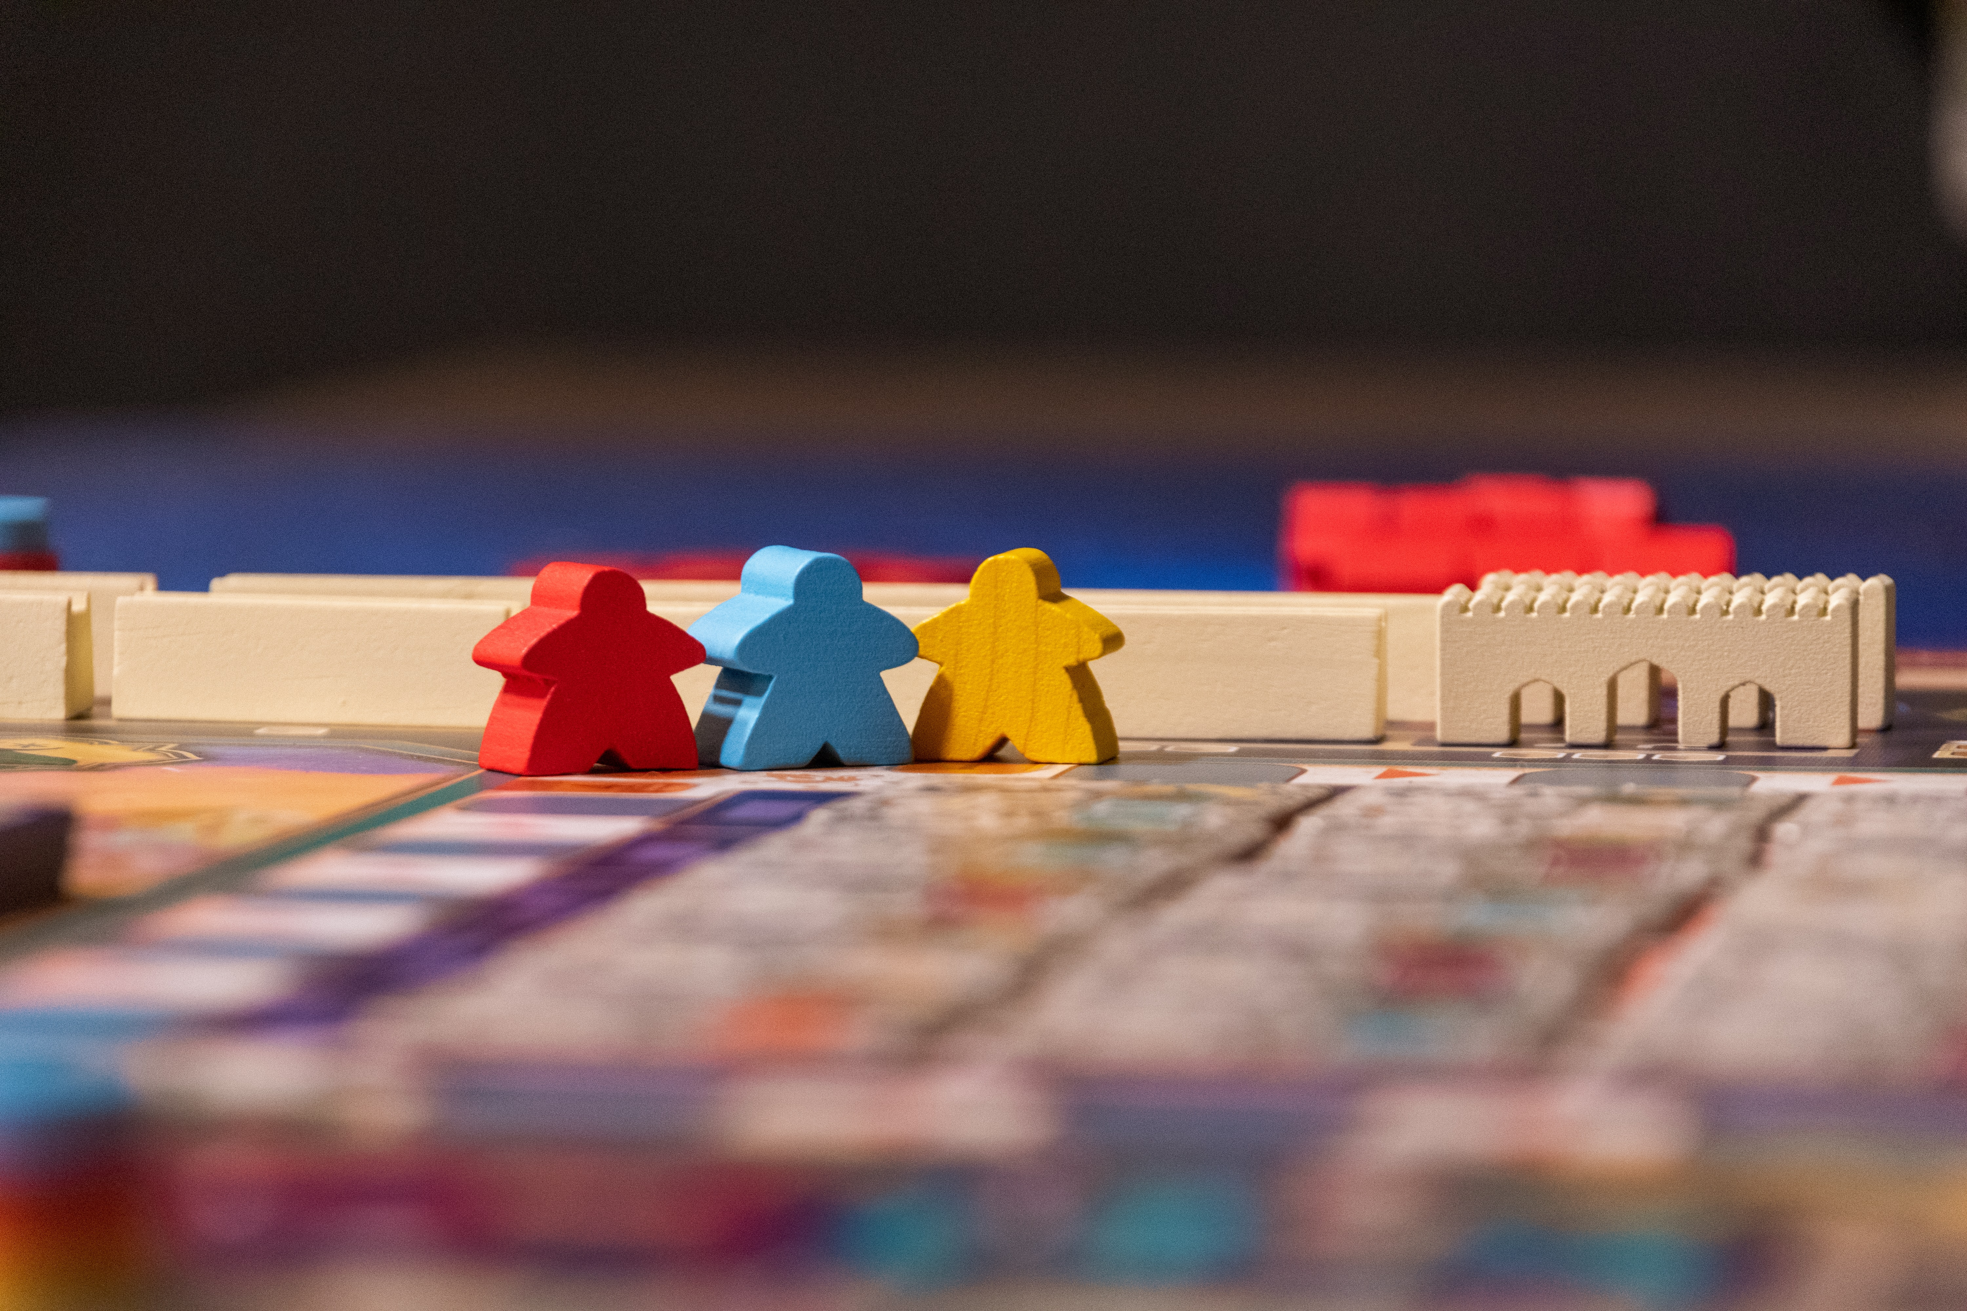
Personas
What is the point?

Slide 17
Why Personas?
Help to empathise with potential users.
Encourages us to see our users as people.
There are issues:
One sided view
Often quite stereotypical
Can be biased
Tend to be ‘static’ (Cutting and Hedenborg 2019)
(Cutting and Hedenborg 2019 - Can Personas Speak? Biopolitics in Design Processes, DIS 2019)

Slide 18
I know who I’m developing for
Do you?
Imagine your organisation – how many people in that organisation are going to be using your system?
Managers? / Users? / Customers? / Auditors?
Are your managers all in the same department?
Are your end users all the same?

Slide 19

Interviewing Clients
Initial Meeting
Be polite
Ask open ended questions
Take clear notes
Ask for clarifications
Make suggestions

Slide 20
Open Ended Questions
Require more than a yes / no answer
Try and keep them open in the initial interview.
Try and come up with a list of questions before going to the meeting.
Come up with possible follow on questions / alternatives.
Examples are:
What does the system need to do?
Who is likely to use the system?
What current alternatives do you use?

Slide 21
Clear Notes
You can ask your client if you can record them.
If you do this be careful what you do with the recording / where it is saved & stored.
Alternatively – take detailed notes.
- Maybe pre-prepare something to write on that aligns to the questions you are asking them?

Slide 22
Getting Clarification
Don’t leave if you’re unsure about what your client wants.
Questions that might elicit good, clear responses are:
What are your minimum expectations for this system?
What do you need the system to do?
How will this system help solve the problem you have?

Slide 23
Making Suggestions
Your client is the one who has the initial idea and you want to make them happy.
HOWEVER:
You have expertise – you’re likely the ones with the technical knowledge.
If what the client asks for isn’t possible – better to suggest an alternative than just say no.
Clients are much more amenable to alternatives than they are to someone saying ‘that’s not possible’.
Also – don’t be afraid to say ‘I don’t have the expertise for that’.
Try not to promise what you can’t deliver.

Slide 24
Week 3 expectations.
As a minimum you need to have:
Met with your client
Have an initial list of requirements
Agreed on a persona each
Have brainstormed potential subsystems

Slide 25
Questions?

